Slide 1
Statistics for Linguists
Adam J.R. Tallman
2023-01-24

Slide 2
From last class
Hierarchical model

Slide 3
For this class
Logistic regression
Conditional inference trees

Slide 4
Loglinear model
A loglinear model is a method for modelling binary data.
The basic ideas can be extended to non-binary data as long as they can be organized into levels.
It is typically used when the dependent variable is binary and there is na interest in knowing how a change in x effects the probability that something is y (y =1, not y =0)

Slide 5
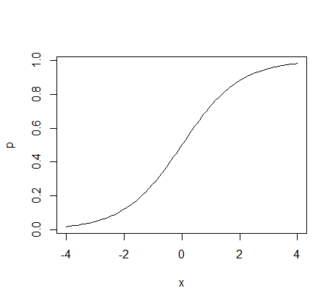
Logistic regression

Slide 6
Logistic regression
The logistic regression is a method for modelling binary data.
The basic ideas can be extended to non-binary data as long as they are organized into levels.
It is typically used when the dependent variable is binary and there is an interest in knowing how a change in x effects the probability that something is y.

Slide 7
Logistic regression
Psycholingustic experiments where subjects have to give yes or no answers.
Various uses in natural language processing
Predict the risk of developing a specific disease
Predict the probability that someone will vote for a particular political party.
...

Slide 8
Logistic regression
A logistic regression or logit model can be represented with the following equation.

Slide 9
The logistic function
But let’s back up a bit to see why this makes sense and what this means ...

Slide 10
Bernouilli distribution
A Bernouilli distribution is a discrete distribution with two possible outcomes.
We want to account for the distribution of y.
You can model it with rbinom()
data <- rbinom(20, 1, 0.5)
data

Slide 11
Logistic function
The important point about log odds ratios as that they take any numbers and transform them to a number from 0 to 1 along a sigmoid shape.
Why is this good?
Because we are interested in modelling a binary outcome,0 or 1, and we want to have a function that translates the effect of predictors into that scale for y.

Slide 12
Logistic function
Any value of x will be transformed into a number that varies from 0 to 1 with ceiling effects.

Slide 13
Logistic regression
y is bounded to 0 or 1
The relationship between x and y has a ceiling effect (like logarithms)
Let’s run a simulation model to get the feel for it.

Slide 14
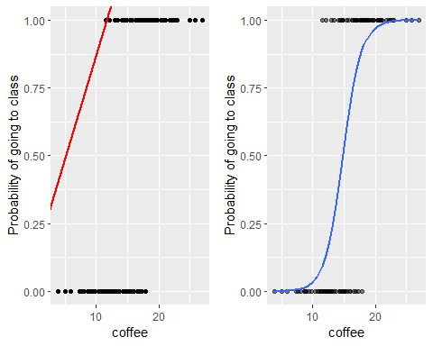
Simulated example
Simulate whether someone will go to class or not.

Slide 15
A real world example
From Levshina
library(Rling);library(rms); library(visreg); library(car)

Slide 16
Two causative constructions in Dutch
Doen relates to direct causation
Laten relates to indirect causation

Slide 17
Interpreting logistic regression coefficients
It is hard to interpret logistic regression coefficients because the relationship is non-linear
The intercept is interpreted assuming 0 for other predictors
But sometimes 0 it not interesting
Alternatively we can interpret the intercept at the center point
Rather than consider a discrete change in x we can compute the derivative of the logistic curve at the central value (where the relationship is steepest
You get this by dividing the coefficient by 4

Slide 18
Conditional inference trees
Basically a data mining tool – most typically used when ...
There is lots of “collinearity” (correlations between lots of predictors) and you are trying to figure out which ones you should use.
Perhaps getting a sense of which of a set of related predictors are best ...

Slide 19
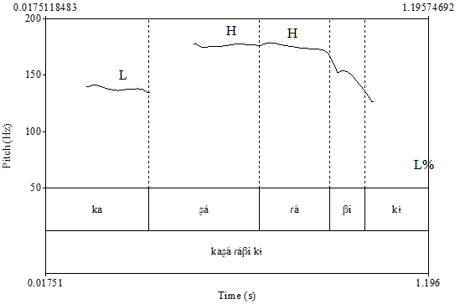
Chácobo pitch measurements
Let’s try this with a subset of tonal data in Chácobo
What types of measurements help with discerning low and high tones.
Obviously something about pitch, but what type of measurement?

